Slide 1
Cyclistic Data Report
Patterns and Trends Between Casual and Member Riders and
Potential Business Strategy

Slide 2
Table of Contents
Business Task
Data Context
The Maximum Ride Length
Average Ride Length
The Most Popular Bike Type
The Most Popular Stations
The Most Busiest Weekdays
Data Analysis and Conclusions
Business Strategy and Marketing Plans
Questions and Answering Session

Slide 3
Business Task
Cyclistic has asked for ways to increase our annual membership rate. We must find a way to entice new and casual riders to agree to join on the membership program.
We also must find out the best ways to market the appeals of membership to casual riders and determine the needs of both member and casual riders to find out how to best supply them and increase our business

Slide 4
Data Context
To do so we gather statistical information from this August to September of last year to make a full year-long study of trends.
With the provided dataset we used Excel and SQL to sort and gather the information we need and have compiled them into separate tables and charts.
The data is distinguished by casual rider statistics and member rider statistics

Slide 5
Maximum Ride Length
We take the ride length by subtracting the end and start time values for every bike sale and categorize them off depending if they are a casual or member rider. Then we sort them to find the highest ride length from the dataset we’re given.
Most of the Maximum values are outliers in the hundreds of thousands of entries, all reaching the range of about 25 hours. There is little deviation between them asides from a bigger outlier in March, where casual and member riders are about the same, with casual riders usually being slightly higher. These outliers should be addressed but not used for intricate analysis on average ride experience.

Slide 6
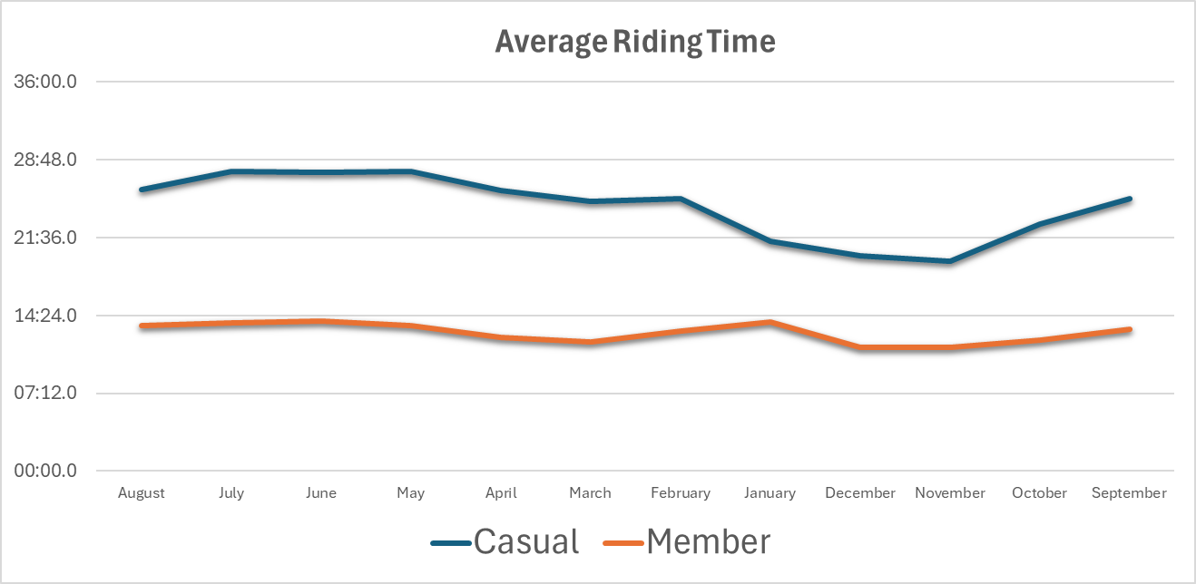
Average Ride Length
We now calculate the average ride length
of casual and member riders through the
year.
We see that casual riders have an
Increased average ride length to the
member ride length.
We also see that casual ride lengths take a
sizeable dip during the winter months,
and are higher in the summer months. As member riders are much more consistent
Increasing in January .

Slide 7
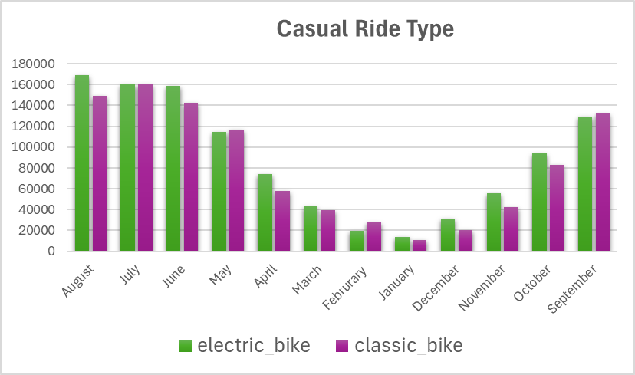
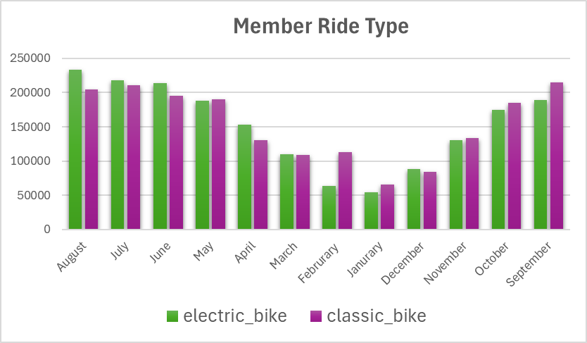
Popular Bikes Sold
We also take a look at the types of bikes
Sold throughout the months, and which
Was more popular to which riders
We see that classic bikes were more
Popular last year but in the recent months
Electric bikes have become more popular
With both riders, with casual riders more
Consistently preferring electric bikes.

Slide 8
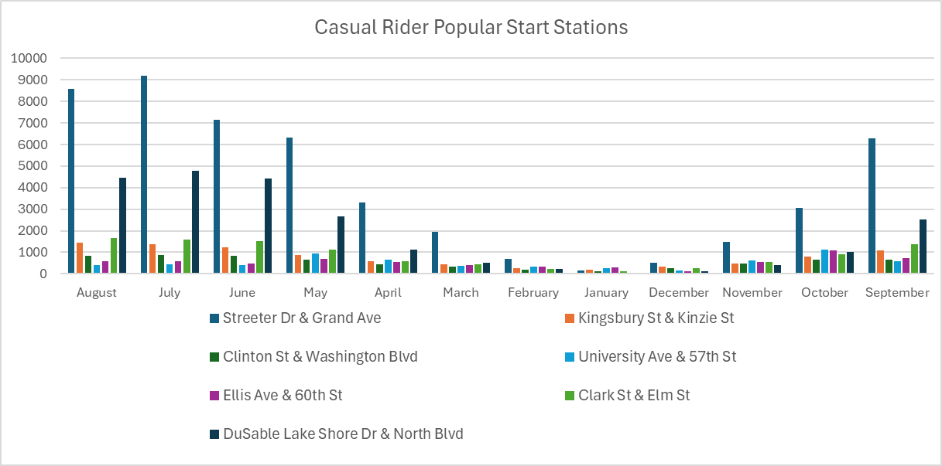
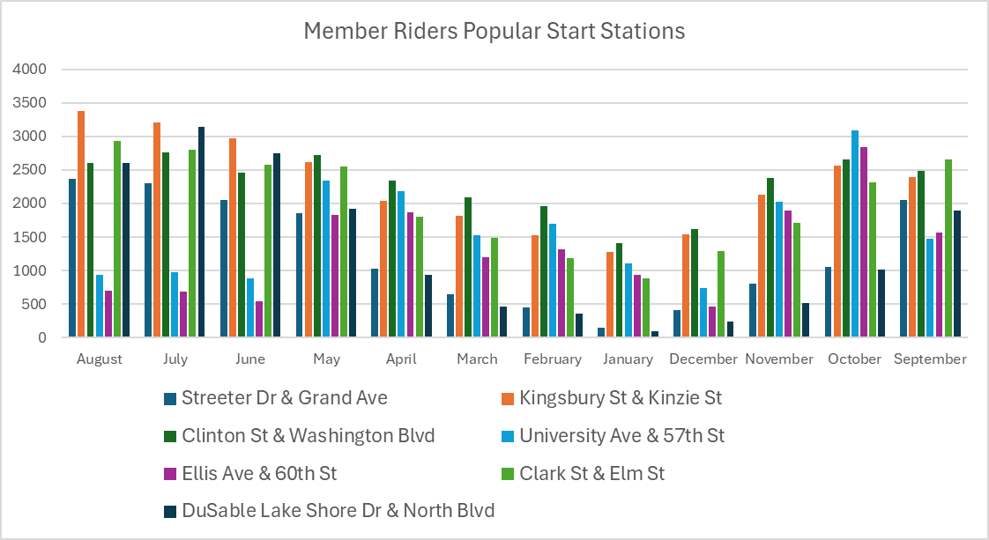
Popular Stations - Starting
We need to see which of our stations
are the most popular with each rider to
find the best location to focus our
marketing
First we examine what is the most
Popular Start Stations for member
and casual riders. Casual Riders nearly
Unanomously prefer Streeter Dr & Grand
Ave to immense amounts and Members
Are more consistent and varied preferring
Stations like Kingsbury & Kinzie St and Clinton
St. & Washington Blvd

Slide 9
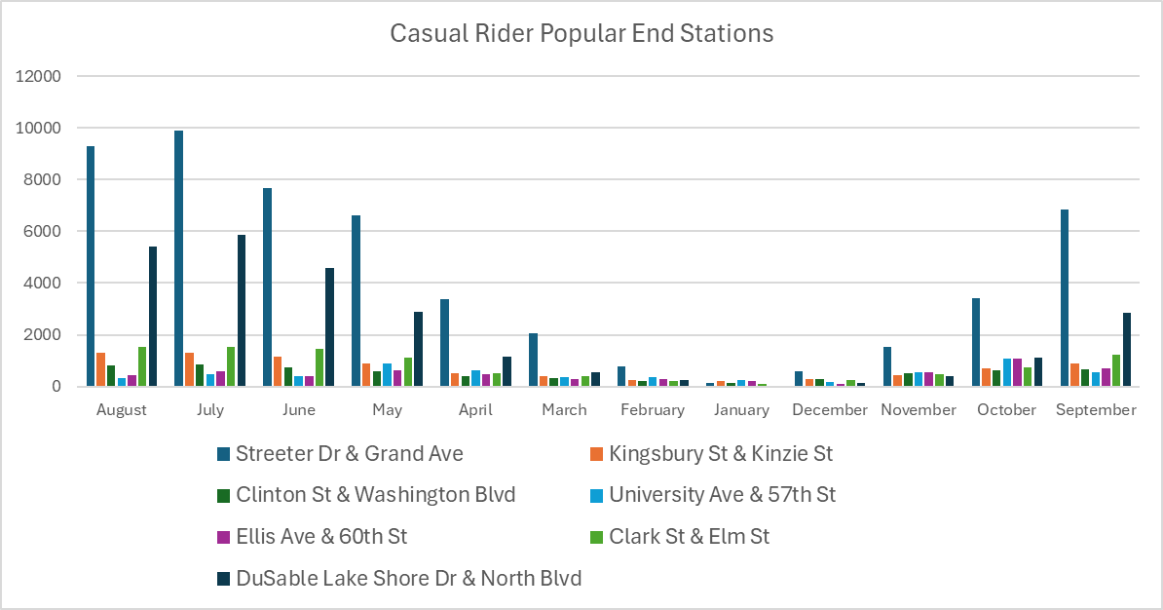
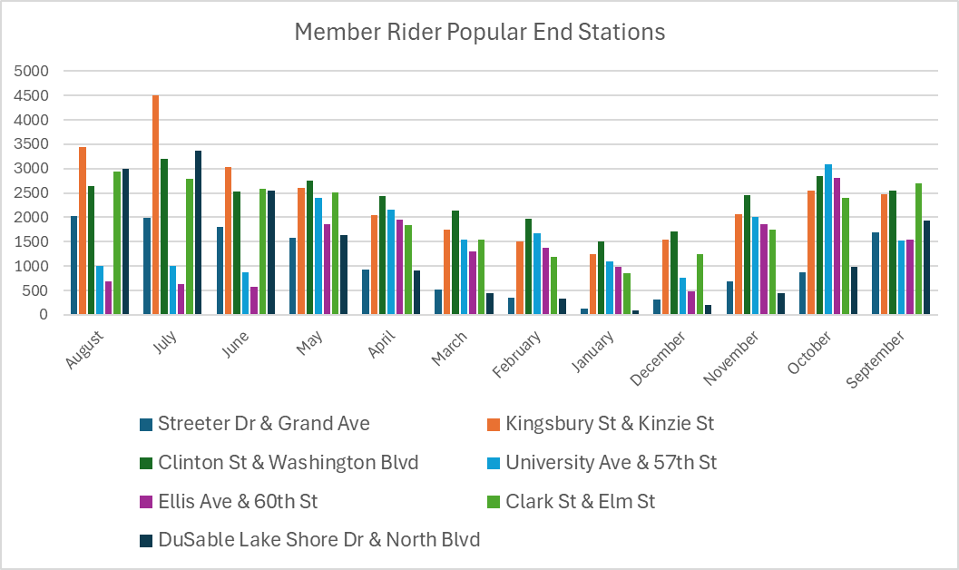
Popular Stations - End
Next we take a look at the most
popular stations riders ended their
rides on.
Like for start stations, the nearly
Unanimously the most popular end
Station for casual riders is Streeter Dr &
Grand Ave. And for members its also
More consistent but usually Kingsbury St & Kinzie St and Clinton St &
Washington Blvd

Slide 10
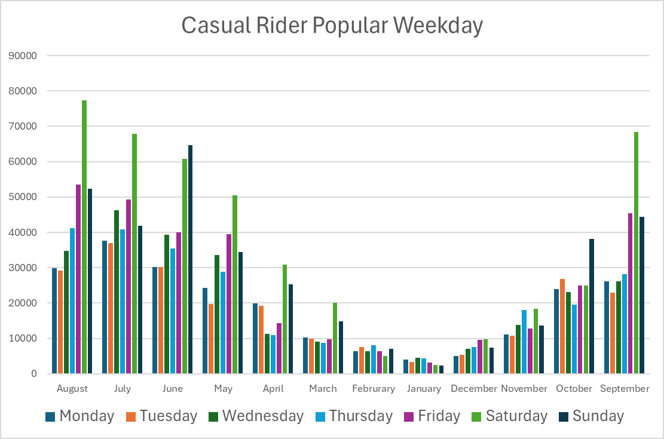
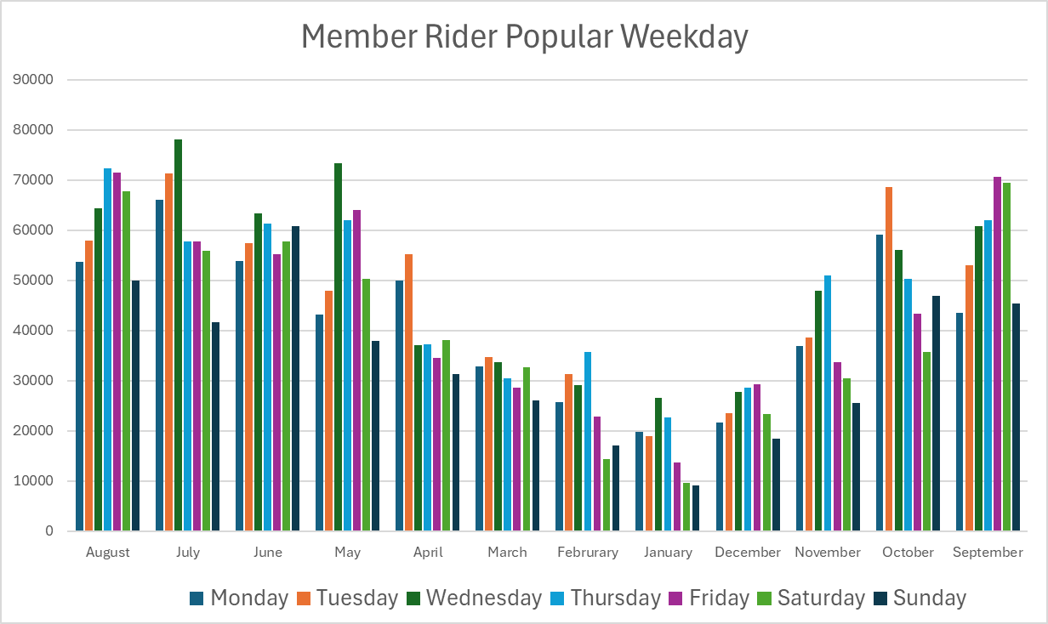
Most Popular Day
We check the busiest days for casual
and member riders.
With the data context we find that
Casual Riders much prefer to ride on
Saturday and other weekends, sometimes
As much as Sunday, as Member riders almost
always prefer Weekdays, mostly
Wednesday, Tuesday, and Thursday

Slide 11
Data Analysis and Conclusions Part 1
With the data gathered, some observations become apparent
For Casual Riders
Casual Riders usually ride much longer than member riders
Casual Riders prefer to ride the most during weekends
Casual Riders prefer to start and stop at Streeter Dr & Grand Ave
Casual Riders take a large dip during the winter months
For Member Riders
Member Riders ride much less than casual riders
Member Riders prefer to ride the most during the weekday
Member Riders start and stop at multiple places, largely Kingsbury St & Kinzie St. and Clinton St & Washington Blvd

Slide 12
Data Analysis and Conclusions Part 2
From the data, it seems that most casual riders use the services for sightseeing and tourism, taking advantage of good weather and weekends for leisure travel time.
With Chicago’s large amount of destinations and landmarks, it makes sense why casual people would use services for exploring the city more
If casual riders are largely comprised of tourists it makes sense on why the
membership numbers would be lower.
Member riders likely use the services for work commutes, which has a lower average ride time compared to casual leisure travel and dominantly use the services during the weekdays.
The average ride is more consistent due to members dependence on the service to

Slide 13
Business Strategy and Marketing Plans Part 1
With the analysis we can suggest potential ways to take advantage of the findings for our marketing
Focus marketing on Streeter Dr & Grand Ave as that is the location with the largest congregation of casual riders and during Saturday or the weekends to take advantage of the increased patrons.
Promote memberships as easier ways to commute to work targeting Chicago citizens
Acknowledge the health and environmental benefits to biking to work
and avoiding traffic to convince riders to join the membership

Slide 14
Business Strategy and Marketing Plans Part 2
Use a marketing strategy to promote leisure bike travel to members, increasing ride time and promoting a biking culture to convince casual riders to go to membership.
Since Electric Bikes are becoming more popular than classic bikes, promote them as well and have them more available through the popular stations.
Create deals and sales on membership prices during the busier days and locations, to encourage more casual riders to purchase the memberships

Slide 15
Questions and Answering
Now that the presentation is finished, I will take any questions on what was recently covered and try to answer them. If you need to get into contact with me for more information or discussion after, I will provide my contact information after the presentation. If anyone needs to go back to a previous slide, feel free to ask

